Slide 1
DroNet: Learning to fly by driving
Paper by: Antonio Loquercio, Ana I. Maqueda, Carlos R. del-Blanco, and Davide Scaramuzza
Presented by: Logan Murray

Slide 2

Video of DroNet in Action

Slide 3
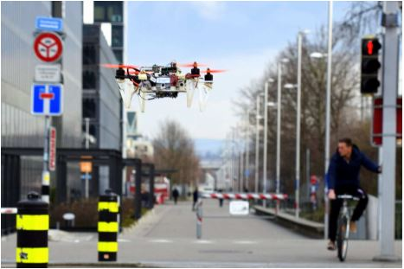
Problem: Safe and Reliable Outdoor Navigation of AUV’s
Ability to avoid obstacles while navigating.
Follow traffic or zone laws.
To solved these tasks, a robotic system must be able to solve perception, control, and localization all at once.
  In urban areas this becomes especially difficult
If this problem is solved, UAV’s could be used for many applications e.g. surveillance, construction monitoring, delivery, and emergency response.

Slide 4
Traditional Approach
Two step process of automatic localization, and computation of controls.
  Localize given a map using GPS, visual and range sensors.
  Control commands allow the robot to avoid obstacles while achieving the desired goal.
Problems with this model:
  Advanced SLAM algorithms have issues with dynamic scenes and appearance changes.
  Separating the perception and control blocks introduces challenges with inferring control commands from 3D maps.
Notes:
*problems with percep and control: also eliminates any possible positive feedback between the two systems.
SLAM is very good at localizing in a 3D environment when it has an explicit construction
HIKER EXAMPLE

Slide 5
Recent Approach
Use deep learning to couple perception and control, which greatly increases results on a large set of tasks
Problems:
  Reinforcement Learning: suffers from high sample complexity
  Supervised-Learning: Must have human expert flying trajectories to imitate
Notes:
RL: because it requires such a large amount of sample data to be able to create the policy for the robot, they would never be able to be applied to an area such as this, where drones will be operating in safety critical environments. It would be too dangerous to let drones operate in this area and potentially injure someone while trying to collect data.
SL: It would be required that you have a lot of expert human pilots making a ton of aerial maneuvers so that the robot can learn how to react in dangerous situations. It would be really dangerous for pilots to collect this kind of data.

Slide 6
DroNet Approach
Residual Convolutional Neural Network(CNN)
Use a pre-recorded outdoor dataset recorded from cars and bikes
Collect a custom dataset of outdoor collision sequences
Real-time processing from one video camera on the UAV
  Create steering angle controls and probability of collision
Have a generalized system that can adapt to unseen environments.
Notes:
Does not try to replace the “map-localize-plan” approach, but rather build a system that could work hand in hand with that approach.
Their goal was basically to have one stream of video input, and to be able to derive control commands and and process visual input
REQUIRES NO STATE ESTIMATION OR PILOT EXPERT DATA

Slide 7
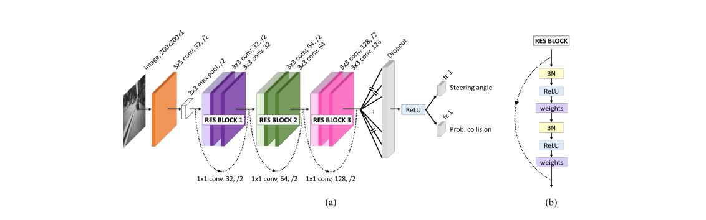
CNN process
Notes:
The shared part of the architecture consists of a ResNet-8 with 3 residual blocks (b), followed by dropout and ReLU non-linearity.
Convolution: convolves across the entire image by a certain stride, filtering the image
Max pool: takes the max value in that range and stores it as output.
Resnet: surpassed humans with image detection/ too complicated for this lecture but (DRAW GRAPH ABOUT ERROR AND DEPTH OF THE CNN)
n first the kernel’s size, then the number of filters, and eventually the stride if it is different from 1. (hyperparameters)
Dropout: zeros out some of the pixel intensities to increase the generalization
BN- batch normalization: eliminates internal covariate shift. ReLu- deals with the vanishing gradient problem.

Slide 8
Training the Steering and Collison predictions
Steering: Mean-Squared Error(MSE)
Collision Prediction: Binary Cross-Entropy(BCE)
Once trained, an optimizer is used to compute both steering and collision at the same time.
Notes:
Assumes gaussian distributed MSE
BCE uses something similar but for classification where the inputs are between 0 and 1

Slide 9
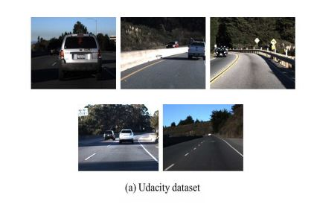
Datasets
Udacity dataset of 70,000 images of car driving. 6 experiments, 5 for training, 1 for testing.
  IMU, GPS, gear, brake, throttle, steering angles, and speed
  One forward-looking camera

Slide 10
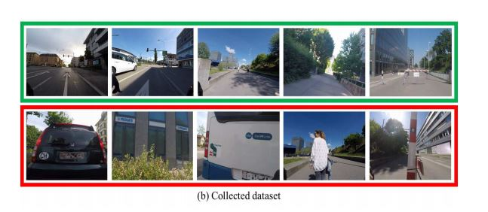
Datasets (cont.)
Collision dataset collected from a GoPro mounted on the handlebars of a bike.
  32,00 images distributed over 137 sequences for a set of obstacles.
Frames that are far away from obstacles are labeled with 0(no collision), and frames that are very close are labeled with a 1(collision).
  Should not be collected by a drone, but are necessary.

Slide 11


Drone Controls
Combination of forward velocity and steering angle
  When collision = 0, forward velocity = Vmax
  When collision = 1, forward velocity = 0
Perform low pass filter on the velocity Vk to provide smooth, continuous inputs. Alpha= .7
Steering angle is calculated by mapping the predicted scaled steering Sk into a rotation around the z-axis.
  Then a low pass filter is applied. Beta = .5

Slide 12
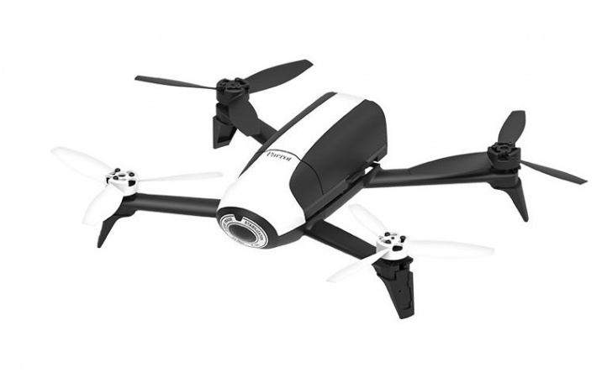
Results
Hardware Specs:
  Drone-Parrot Bebop 2.0 drone
  Core i7 2.6 GHz CPU that receives images at 30 Hz from the drone through Wi-Fi.

Slide 13
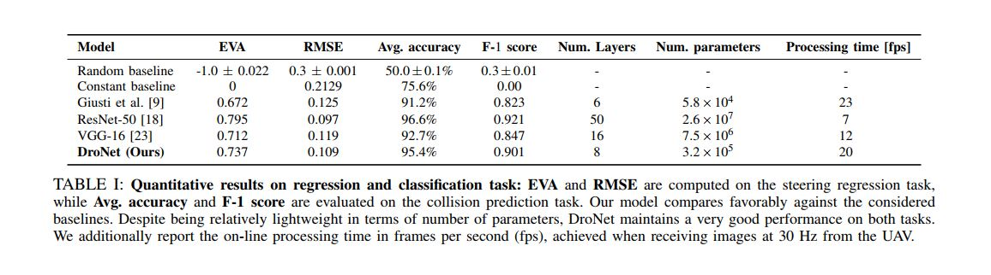
Results (Cont.)
Notes:
1Explained Variance is a metric used to quantify the quality of a regressor, and is defined as EVA = Var[ytrue−ypred ]/ Var[ytrue]
F-1 score is a metric used to quantify the quality of a classifier. It is defined as F-1= 2 precision×recall /precision+recall
RMSE: rootmeansquared
Dronet even though 80 times smaller than the current best architecture, maintains a considerable prediction performance while achieving real-time operation (20 frames per second).

Slide 14
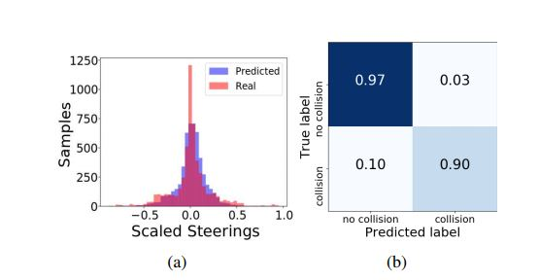
Results (Cont.)

Slide 15
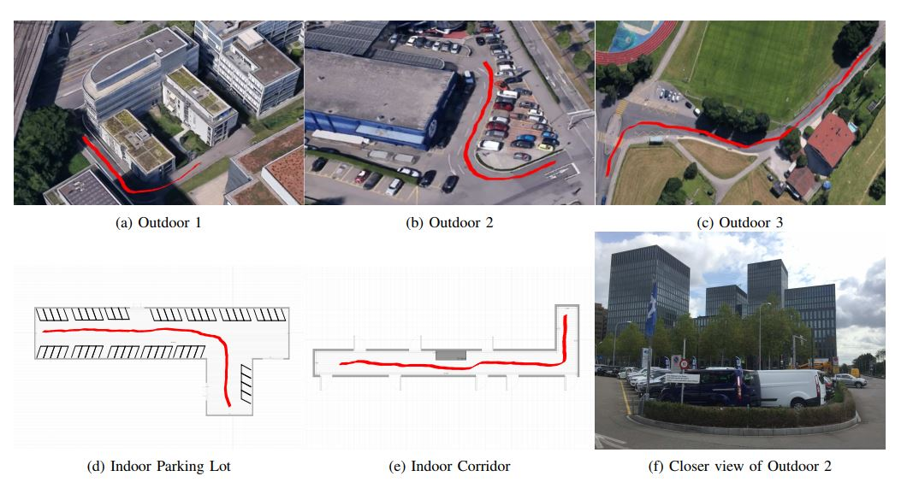
Results(Cont.)
Notes:
Zone A was also tested the drone flying above a 5m altitude with no affects on the operations of the drone. As long as the drone can see the line shaped features that it follows, it can operate.

Slide 16
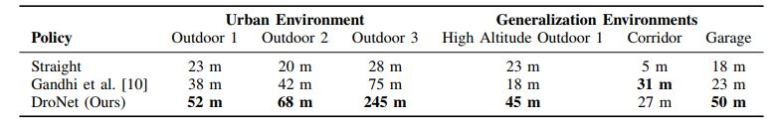
Results(Cont.)

Slide 17
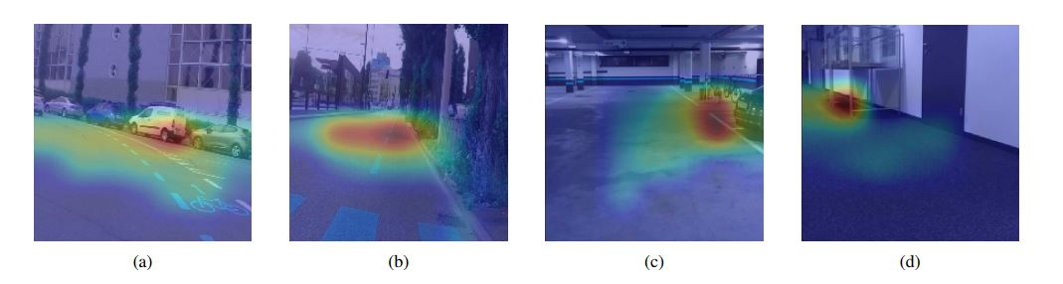
Results(Cont.)
Always produced a safe, smooth flight even when prompted with dangerous situations
  e.g. sudden bikers or pedestrians in front of the robot.
Network focuses on “line-like” patterns to predict crowed or dangerous areas.
Notes:
Activation paths using gradient based localization

Slide 18
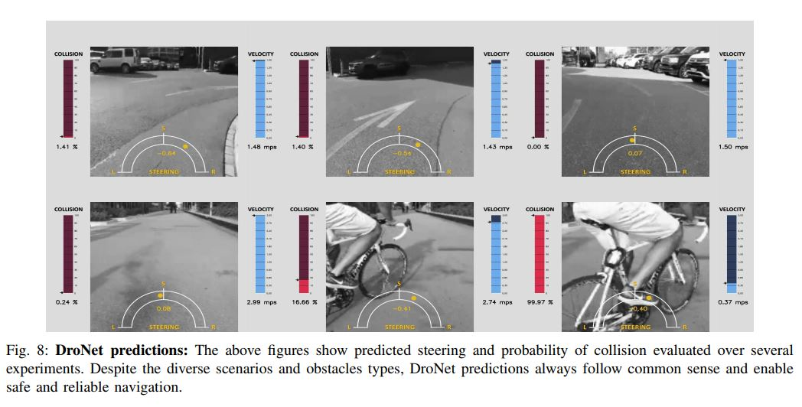
Results(Cont.)

Slide 19
Pros vs Limitations
Pros
  Drone can explore completely unseen environments with no previous knowledge
  No required localization or mapping
  CNN allows for high generalization capabilities
  Can be applied to resource constrained platforms
Limitations
  Does not fully exploit the agile movement capabilities of drones
  No real way to give the robot a goal to be reached
Notes:
To deal with movement, one could use 3D collision free trajectories when in high probability of collision.
For the goal, you could provide a network with a rough estimate of distance to the goal. Or provide a 2d map and use a learning-based approach for ground robots.

Slide 20
Refereneces
A.Loquercio, A.I. Maqueda, C.R. Del Blanco, D. Scaramuzza DroNet: Learning to Fly By Driving IEEE Robotics and Automation Letters (RA-L), 2018
Deshpande, Adit. “A Beginner's Guide To Understanding Convolutional Neural Networks.” A Beginner's Guide To Understanding Convolutional Neural Networks – Adit Deshpande – CS Undergrad at UCLA ('19), 20 July 2016, adeshpande3.github.io/A-Beginner's-Guide-To-Understanding-Convolutional-Neural-Networks/.

